Slide 1
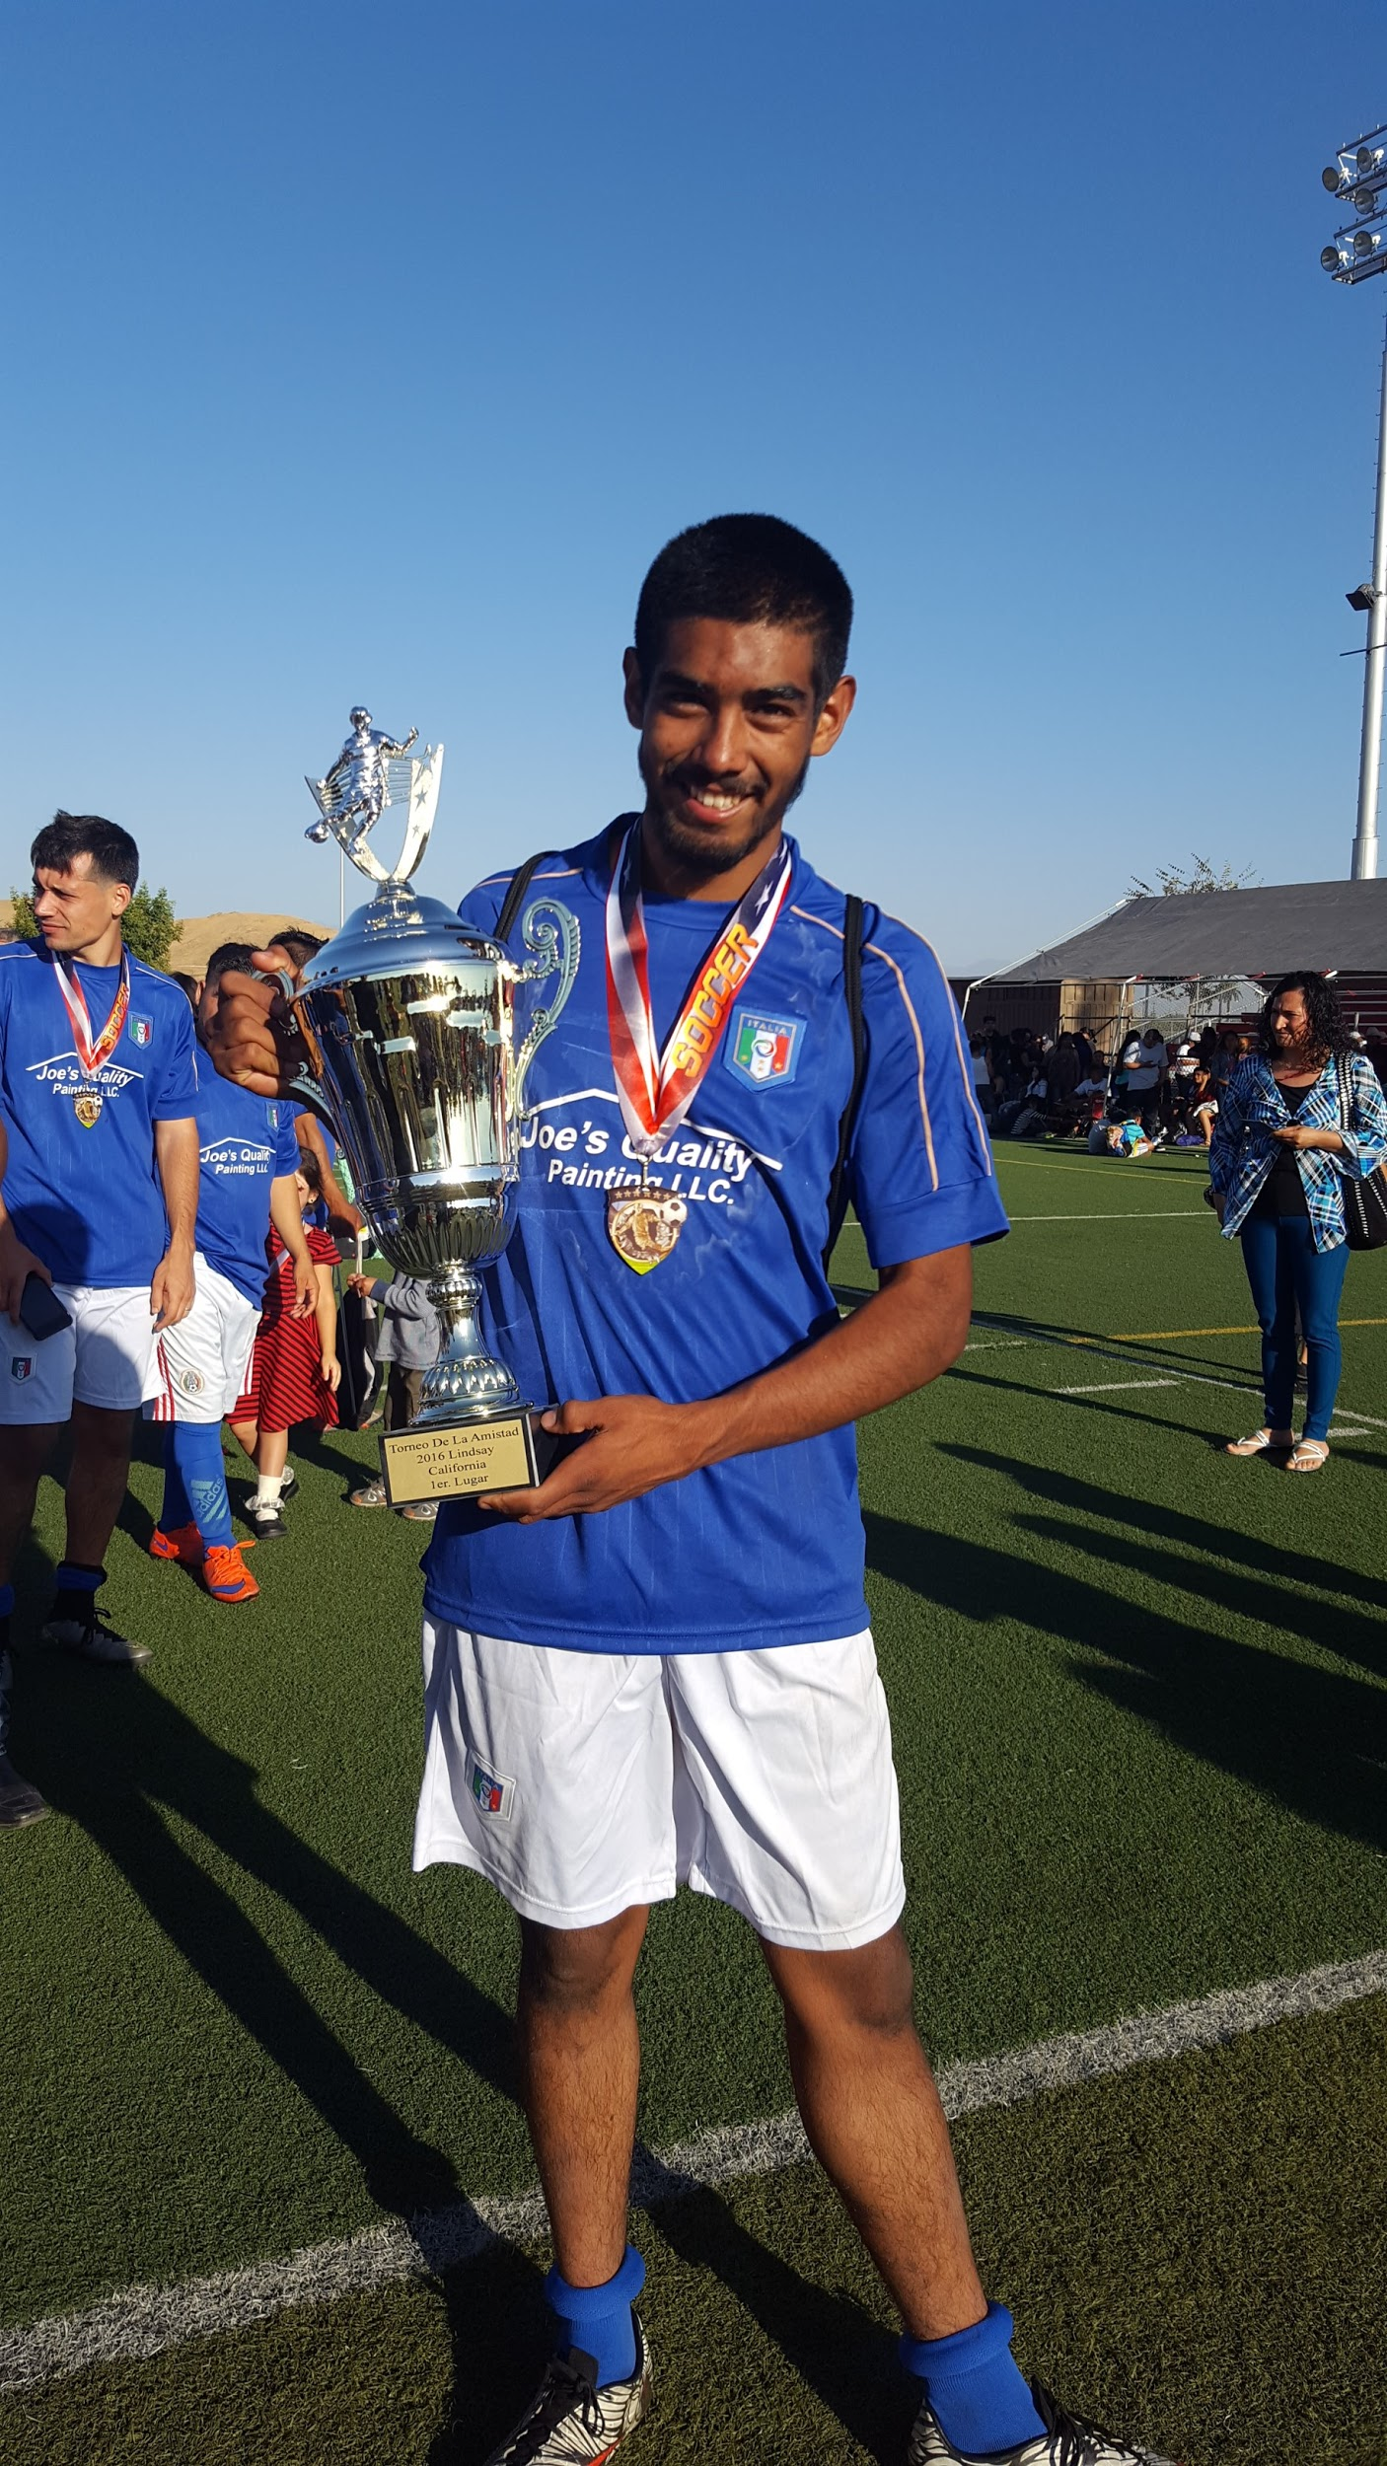
Exit Interview
By: Jose Ortiz

Slide 2
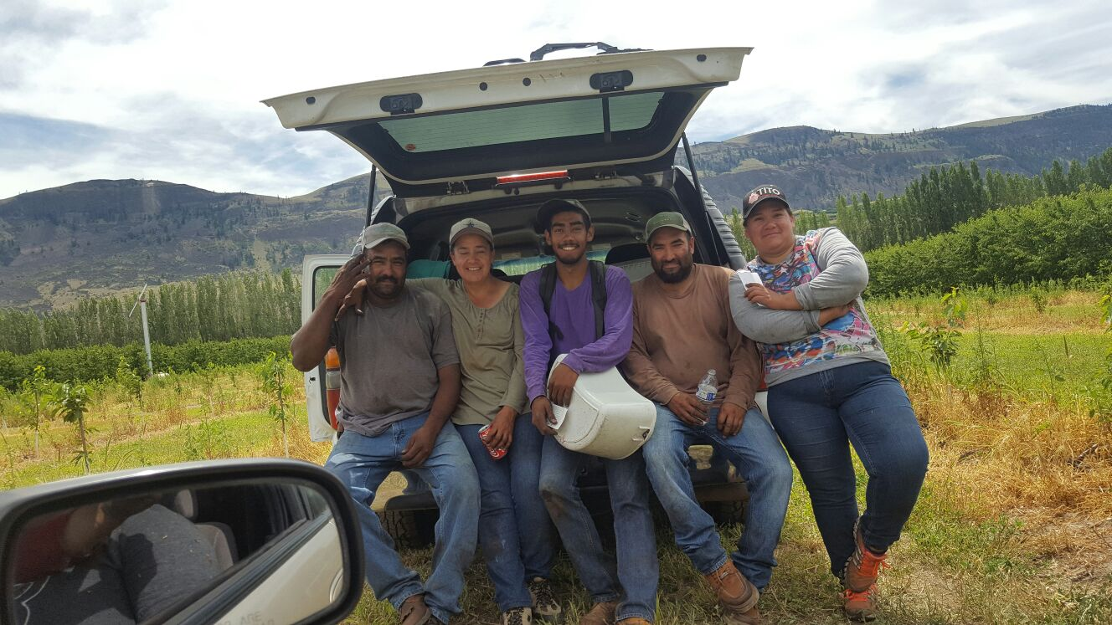
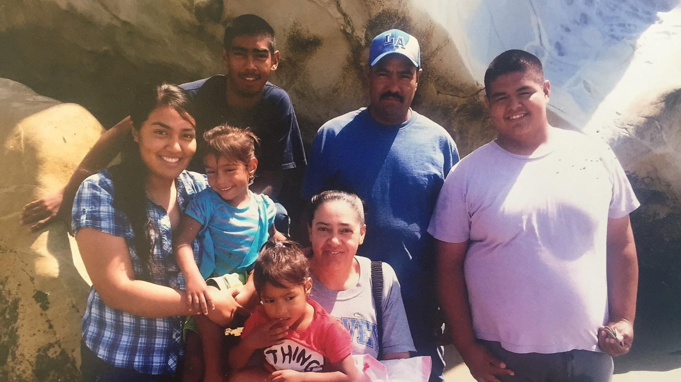
About me
Family background
Personal challenges
Hands on stuff

Slide 3
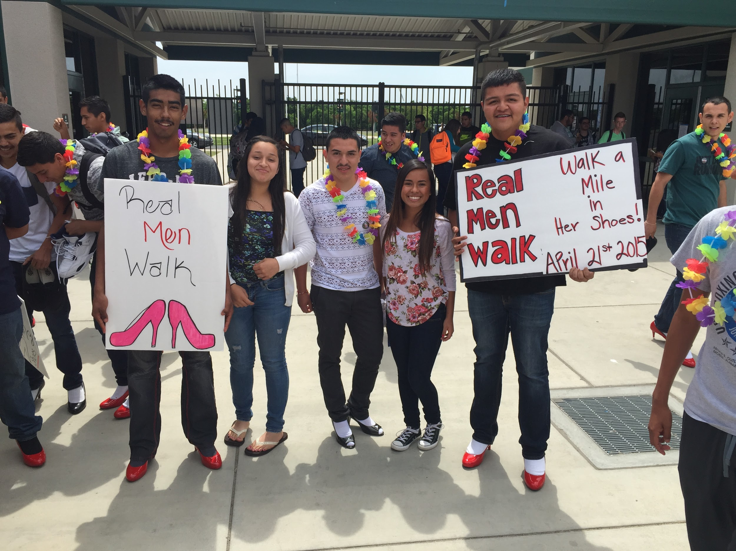
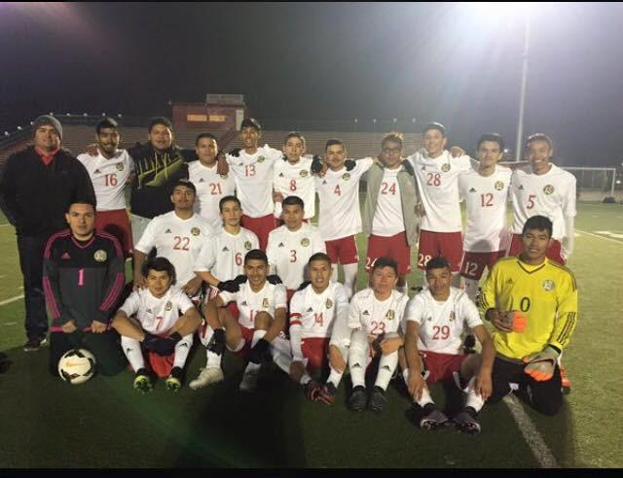
High School Experience
Soccer
Cross Country
Ap Spanish Language
Walked on heels

Slide 4
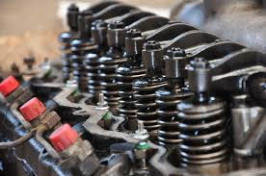
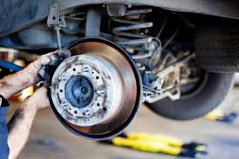
Job Shadow
Mechanic
Hands on activity
Experience

Slide 5
Post-high School Plans
CSU Bakersfield
Electrical Engineering
2nd major in mathematics
Why not Mechanic?

Slide 6
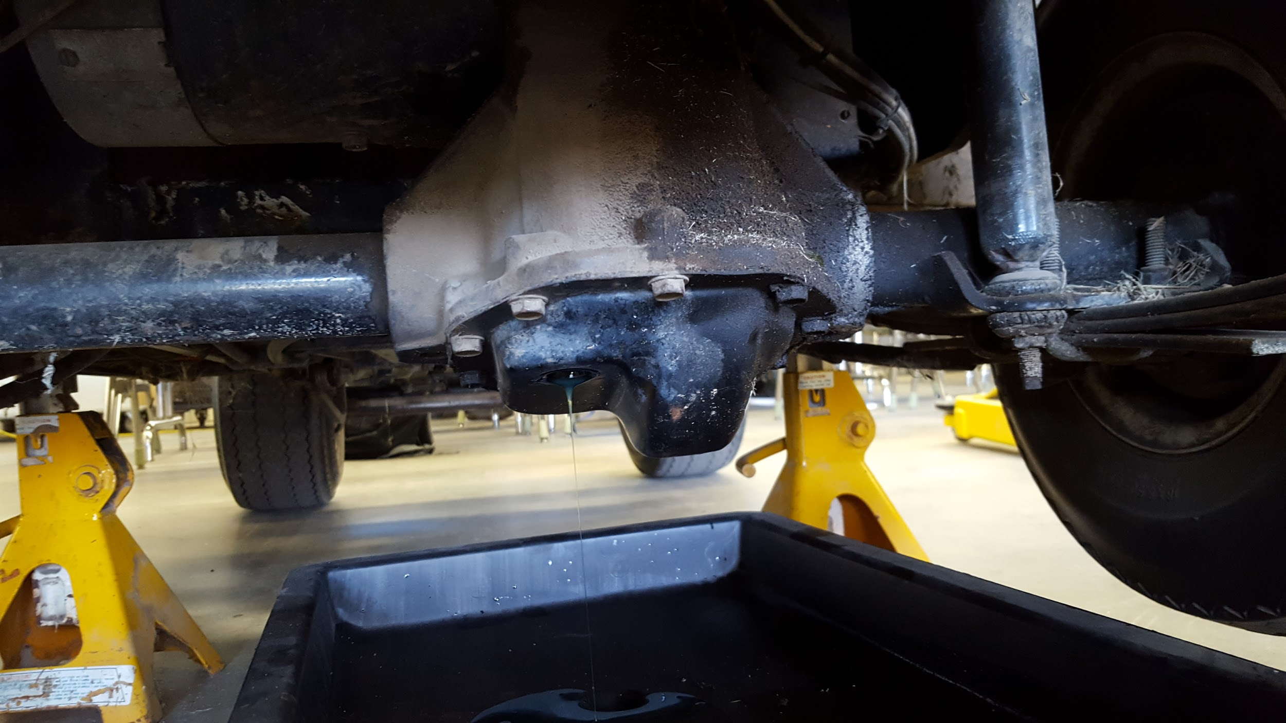
Pathway
Automotive
Auto 1
Auto 2

Slide 7
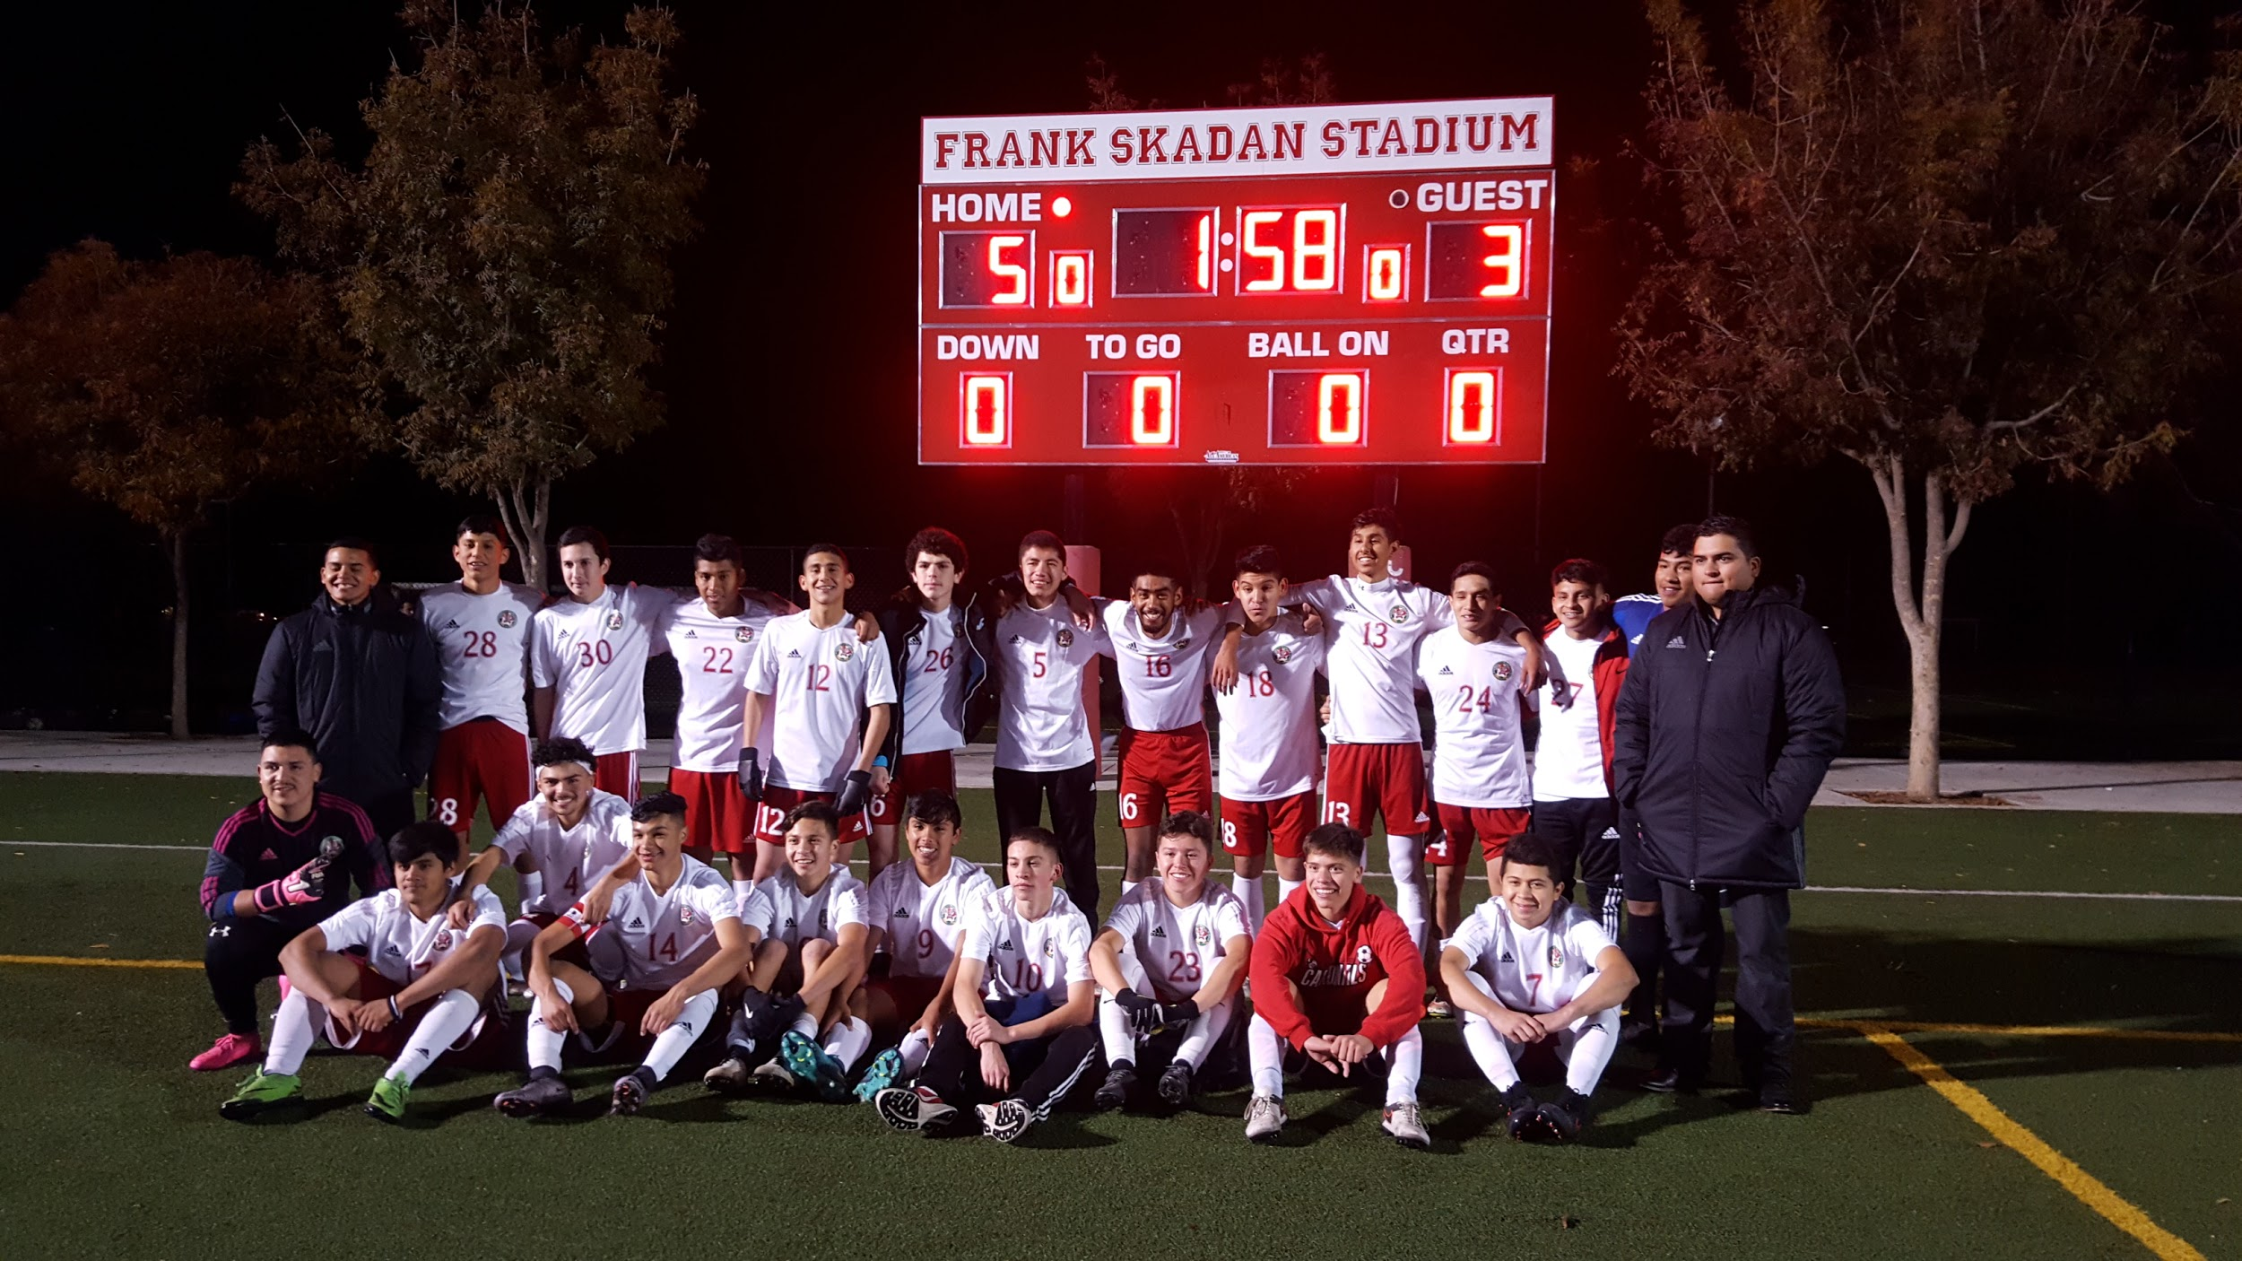
Leaving LHS
LHS Experience
How did teachers shaped me?

Slide 8
Any questions?

